Slide 1
Simulation
Stochastic modeling

Slide 2
Random objects
Random objects and base generator
Random events
Random variables
Random processes
Random point processes
BG
Transformation
α
X

Slide 3
Discrete RV
methods of generation

Slide 4
Discrete RV given by distribution
A₁
A₂
…
A_{m}
no
yes

Slide 5

Laboratory #10
Assignment:
Dice game (+cheating dice)

Slide 6
Statistical processing for discrete RVs
Relative frequencies
n_{i} is the number of appearances of value i (they are named as frequencies), N is the total number of trials
Empiric expectation (average):
Empiric variance:
Mathematical expectation (mean):
Absolute errors:
Variance:
Relative errors:

Slide 7
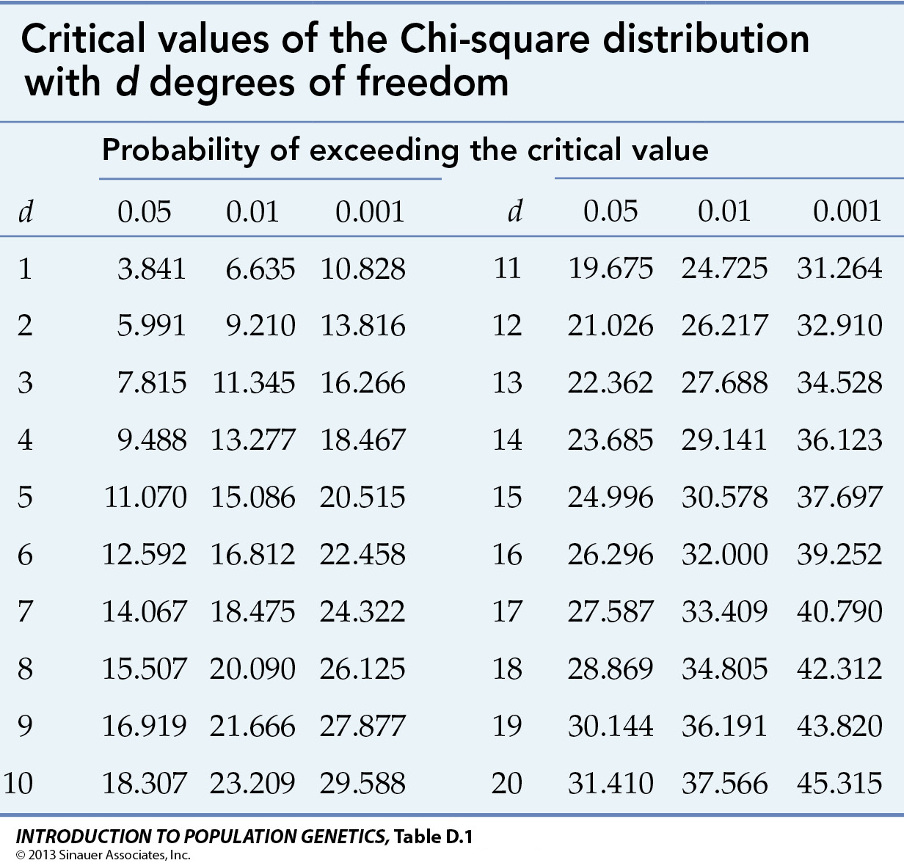
Statistical processing for discrete RVs
Chi-squared test
m
m
Hypothesis that empiric distribution corresponds to the theoretical one is not true if and only if
α is a significance level

Slide 8
Laboratory #11
Assignment:
Statistics processing of discrete random variable simulation
Prob 1
Prob 2
Prob 3
Prob 4
Prob 5
auto
Average: 2.897 (error = 8%)
Variance: 2.072 (error = 9%)
Number of experiments
Start
Chi-squared: 13.51 > 9.488
is true

Slide 9
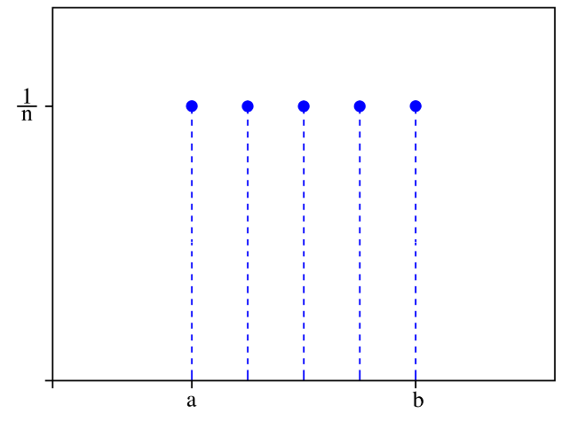
Uniform discrete distribution
From 0 to n:
From a to b:
generator:
Set n = b - a
Use
Calculate x = x + a
Int is a truncating operation
For example, if x from {1, 2, .., n} then use formula:

Slide 10
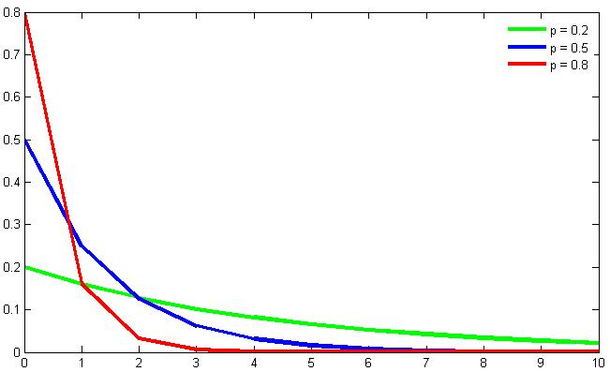
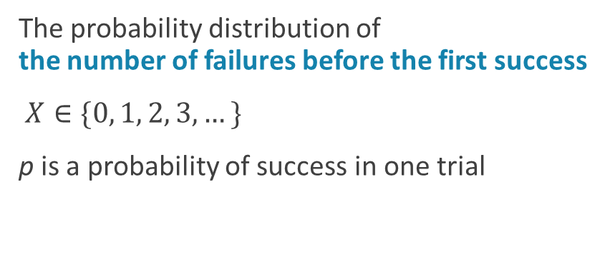
Geometric distribution
The probability distribution of the number of failures before the first success
$X∈\{0, 1, 2, 3,…\}$
p is a probability of success in one trial
generator:

Slide 11
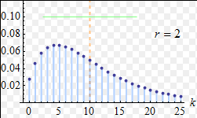
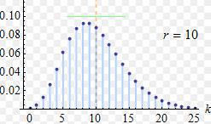
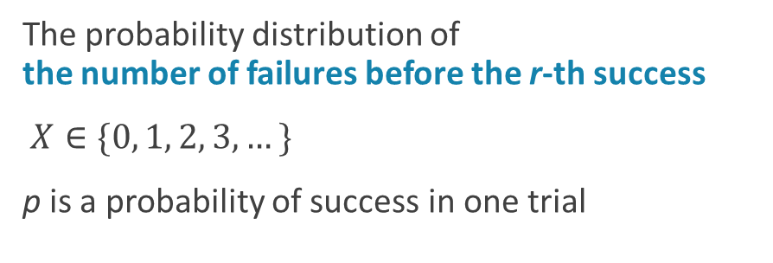
Negative binomial distribution
The probability distribution of the number of failures before the r-th success
$X∈\{0, 1, 2, 3,…\}$
p is a probability of success in one trial
generator:

Slide 12
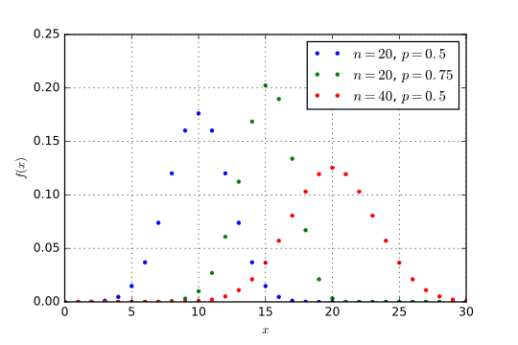
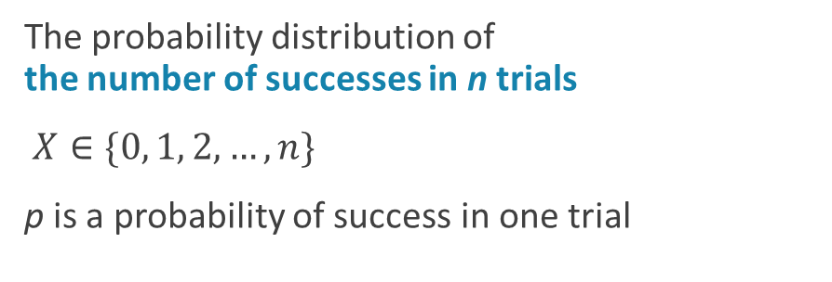
Binomial distribution
The probability distribution of the number of successes in n trials
$X∈\{0, 1, 2,…,n\}$
p is a probability of success in one trial
generator:
where
is a Heaviside step function

Slide 13
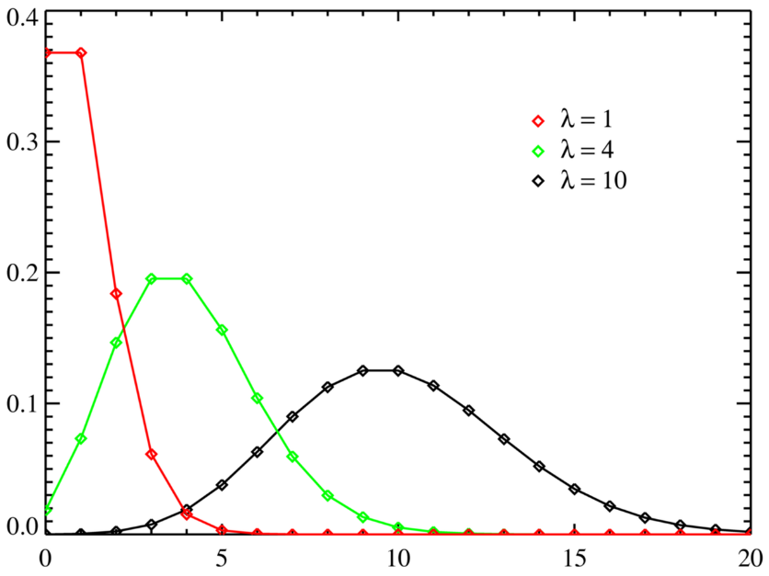
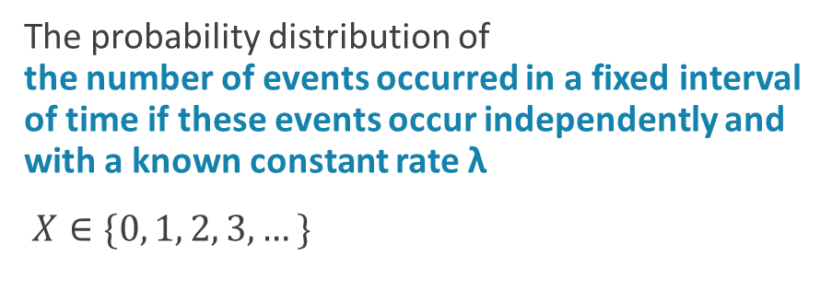
Poisson distribution
The probability distribution of the number of events occurred in a fixed interval of time if these events occur independently and with a known constant rate λ
$X∈\{0, 1, 2, 3,…\}$

Slide 14
Poisson distribution generator
generator:
no
yes

Slide 15
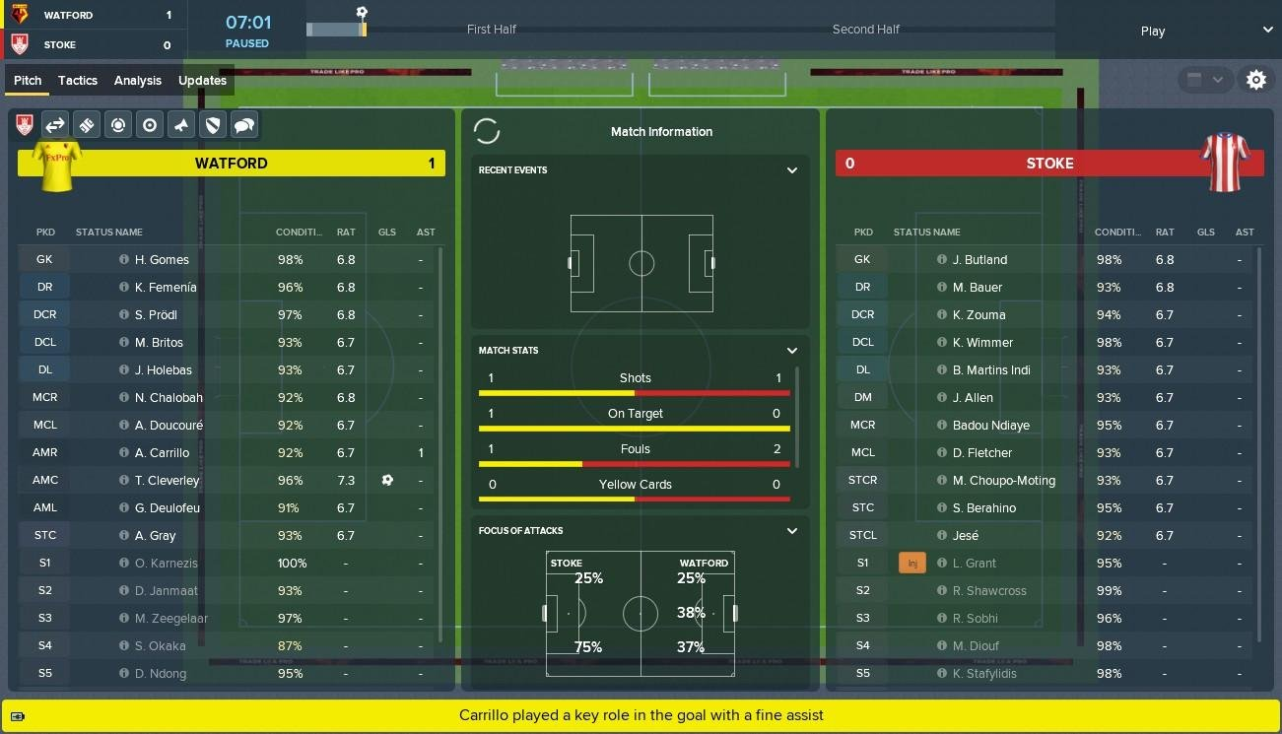
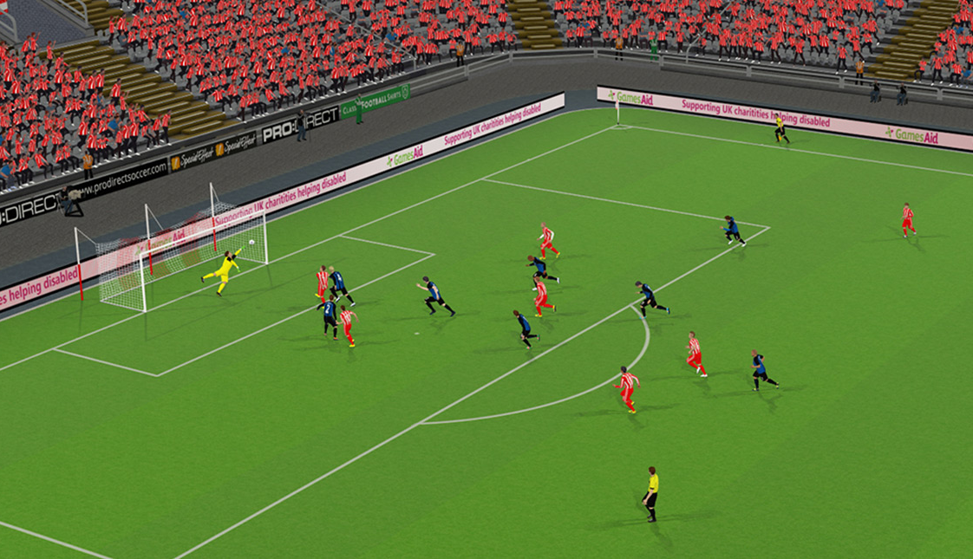
Laboratory #12
Assignment:
Football manager game
Basketball

Slide 16


Laboratory #12
Use Poisson distribution

Slide 17
Statistical processing for discrete RVs with infinite number of values
only for chi-squared criteria!
X:
Example (geometric distribution p=0.8):
“Similar” distribution:
0 | 1 | 2 | >2
0.8 | 0.16 | 0.032 | 0.008

Slide 18
Laboratory #13
Assignment:
Statistics processing of simulation of discrete random variable with infinite number of values
Param 1
Param 2
Number of experiments
Start
Average: 2.897 (error = 8%)
Variance: 2.072 (error = 9%)
Chi-squared: 13.51 > 9.488
is true

